Slide 1

CEIR Operator Training Manual

Slide 2

Product Overview
Operator Definition and Overview
Assumptions
Features
Registration
Dashboard
Block/ Unblock devices
Grey List
Black List
Grievance
Profile Management

Slide 3
Operator - Definition
An entity who provides wireless internet services for mobile device users.
The operator give a SIM Card to the customer who inserts into the mobile device to gain access to the services.
Operator deploy different network technologies like GSM, GPRS, LTE, CDMA etc.

Slide 4
Overview
Operator has to register using DMC Home Portal
As part of registration process, Operator will receive the username and password which can be then used to login to the CEIR Portal
Once logged into the CEIR portal, an operator can use following features
Request to block and unblock devices
Download grey list
Download black list
Grievance
Profile Management
Operator can see the status of ongoing activity through the Dashboard feature
Email Notification to keep track of the status of various operations

Slide 5
Assumption
EIR System are deployed in the operator network
The grey / black list file as downloaded in the offline mode would be uploaded in the EIR system as per policy definition
SLA to be in place to ensure grey/black list are uploaded in EIR in timely manner
In case operator is also an importer, operator has to register separately as importer
Any policy/regulation with respect to IMEI would be implemented in the operator EIR.
Example of such regulation are:
Disallow network access to NULL IMEI or all zeros IMEI
IMEI with incorrect length

Slide 6
Registration – Operator
An Operator has to be a Cambodian Company, registered in Cambodia and holding mobile telecom license to run the mobile service.
An Employee from operator organization will register on the CEIR portal
During registration, employee has to share the details of the reporting manager.

Slide 7
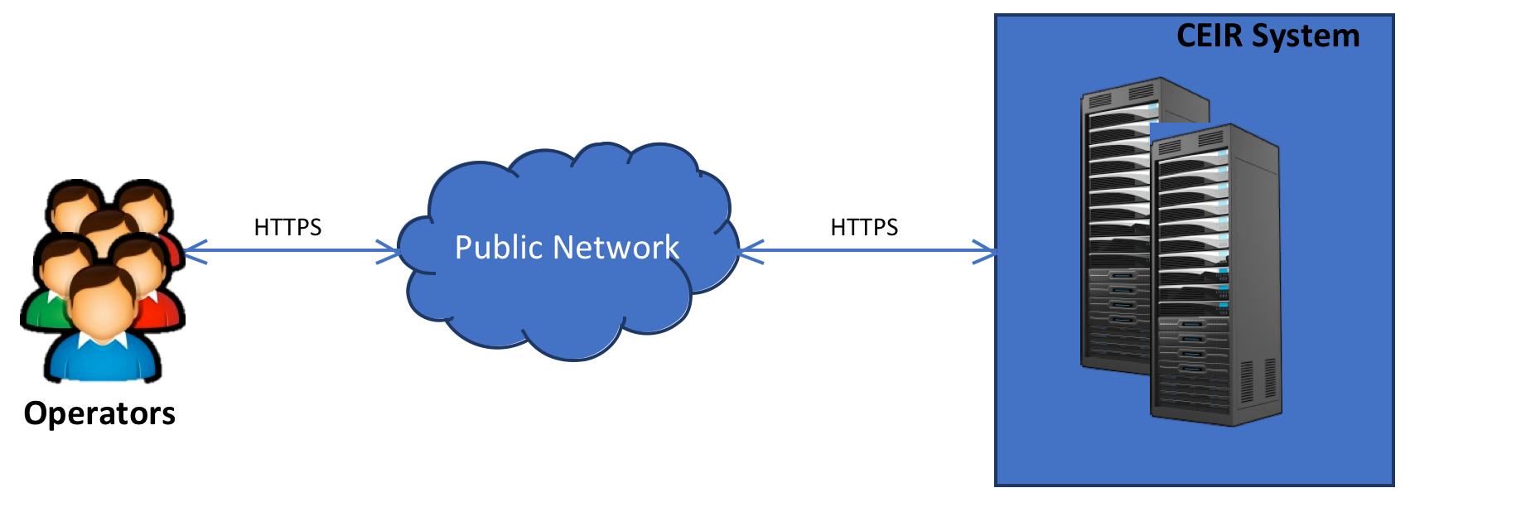
Operator – CEIR Interface

Slide 8
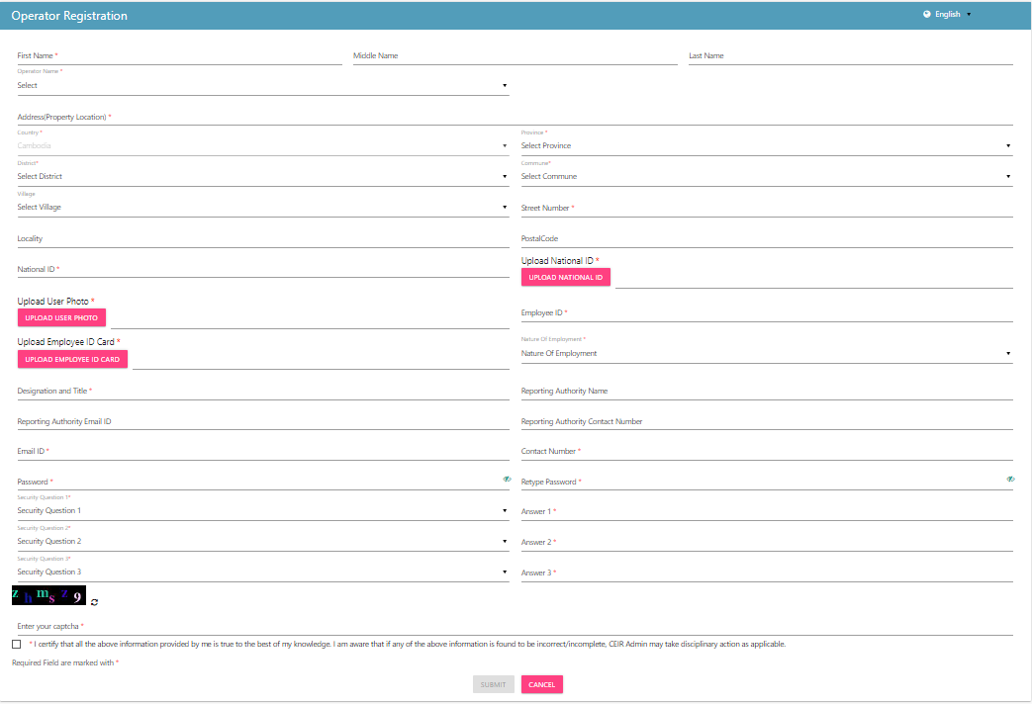
Registration – Operator (Form)

Slide 9
Dashboard – Operator
The Dashboard has information about the following
Total number of Block /Unblock request
Total number of Block/Unblock Devices
Total Grievances raised by the Operator
Notifications on feature requests raised by the Operator

Slide 10
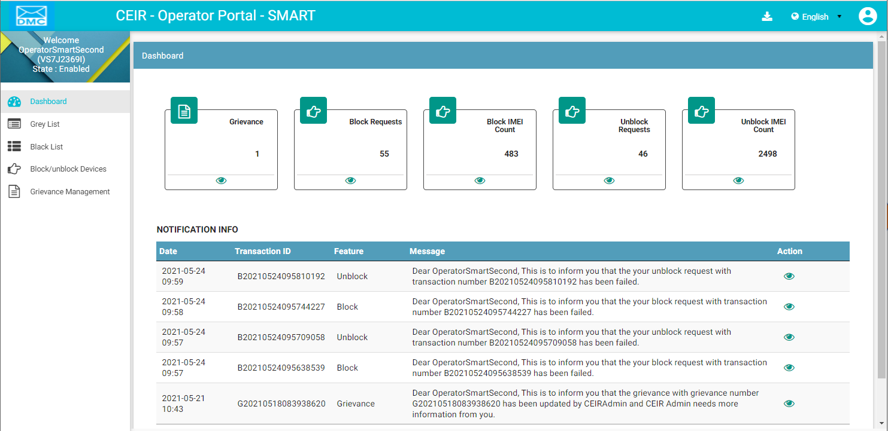
Dashboard – Operator
Download User Manual
Left Panel
Work Area
All features status
Edit Profile
Language Change
On click it takes user to respective home page
Notifications

Slide 11
Block / Unblock Devices – Operator
Operator may block or unblock one or more devices due to various reasons.
One of the reasons could be subscription contract violation between user and operator. Since user has violated the subscription contract, operator may raise a request to block devices.
Once the subscription contract is restored with user, operator will revoke the block request by sending unblocking request
Both single and bulk request mode are supported

Slide 12
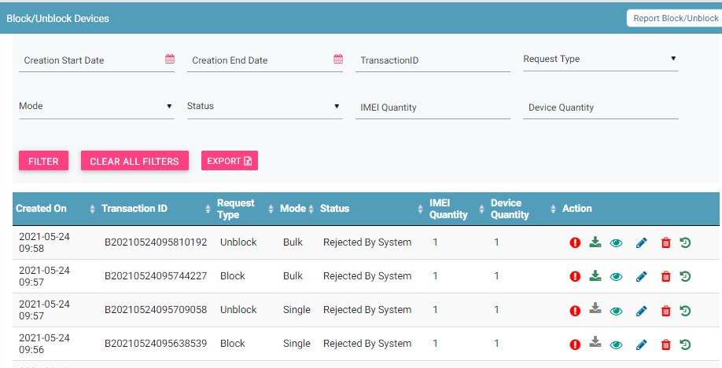
Block / Unblock Devices – Operator
Filters
Report Block/ Unblock
Export
Action like Error, Download,View, Edit & Delete
View All requests

Slide 13
Grey List – Operator
Operator user can download the grey list from the CEIR portal
There are 2 kind of files available:
Full – Contain all the IMEI in grey list till date
Incremental – Contain the IMEI added/deleted in grey list
CEIR System will generate full files on weekly basis and incremental file on daily basis.
Once file is downloaded, the same should be updated on the operator EIR system to bring grey list in effect
Operator can either update full dump or keep updating the incremental dump to keep their grey list in the EIR database in sync with CEIR on daily basis.

Slide 14
Grey List – Add / Delete Scenarios
IMEI is added in grey list in following scenarios:
Device is marked stolen by lawful agency
Device is requested to be blocked by operator
Device is registered by end user but does not pay tax
Device is found in use in network and is not found in whitelist database
Device is found in use in network but visa has expired.
IMEI is deleted from grey list in following scenarios:
Device is marked recovered by lawful agency
Device is requested to be un-blocked by operator
End User pay tax for registered device
End user upload the visa
End user regularize the device by registering and paying tax for same
Device is moved to black list

Slide 15
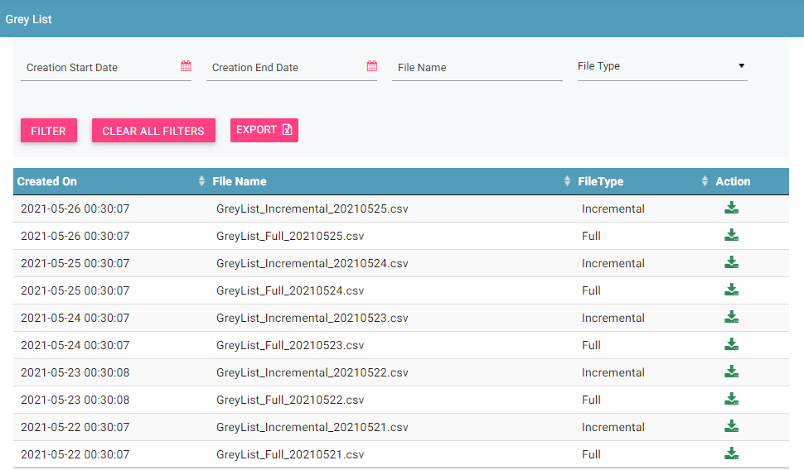
Grey List – Operator
Filters
Export
View All
Download Action
© 2019-2020 Sterlite Technologies Limited
15

Slide 16
Black List – Operator
Operator user can download the black list from the CEIR portal
There are 2 kind of files available:
Full – Contain all the IMEI in black list till date
Incremental – Contain the IMEI added/deleted in black list
CEIR System will generate full files on weekly basis and incremental file on daily basis.
Once file is downloaded, the same should be updated on the operator EIR system to bring black list in effect
Operator can either update full dump or keep updating the incremental dump to keep their black list in the EIR database in sync with CEIR on daily basis.

Slide 17
Black List – Add / Delete Scenarios
IMEI is added in black list in following scenarios:
Monitoring period has expired
IMEI is deleted from black list in following scenarios:
Device is marked recovered by lawful agency
Device is requested to be un-blocked by operator
End User pay tax for registered device
End user upload the visa
End user regularize the device by registering and paying tax for same

Slide 18
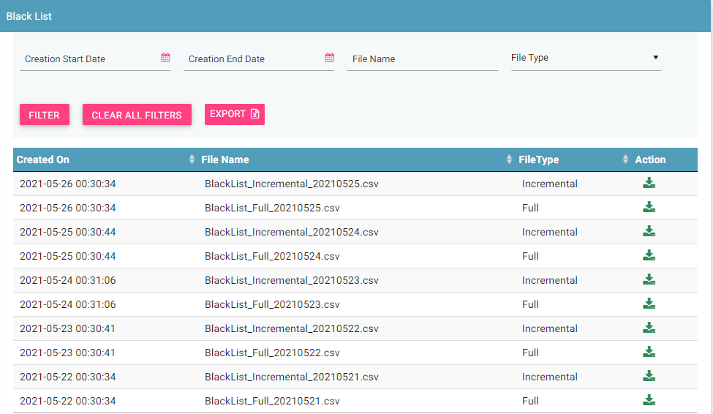
Black List – Operator
Filters
Export
Download Action
View All

Slide 19
Grievance – Operator
As an operator, you can register grievances when there is a problem in the CEIR system.
For example, there could be situations when the registration feature is not working or there could be a problem in downloading grey list file from CEIR portal.
Once a grievance is raised, it reaches the CEIR Admin queue for response from CEIR Authority.
CEIR Admin can ask for more details in case required.
Else CEIR Admin will respond and close the grievance.

Slide 20
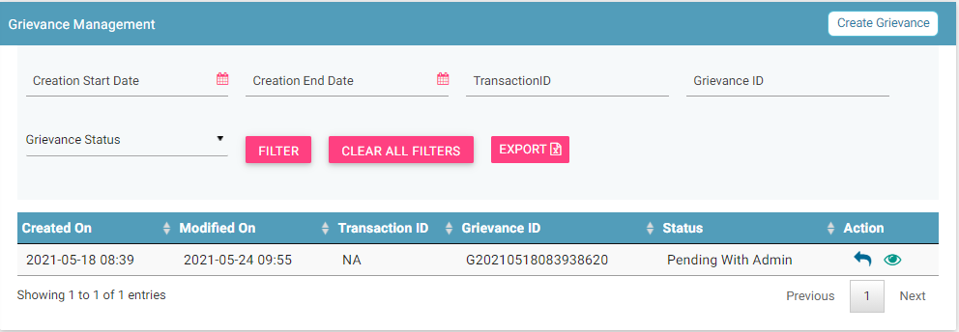
Grievance – Operator
Report
Filters
Export
Action like View, Reply
View All grievances

Slide 21
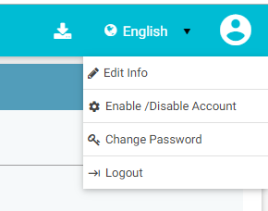
Profile Management

Slide 22
Queries

Slide 23
Thank You

